Slide 1
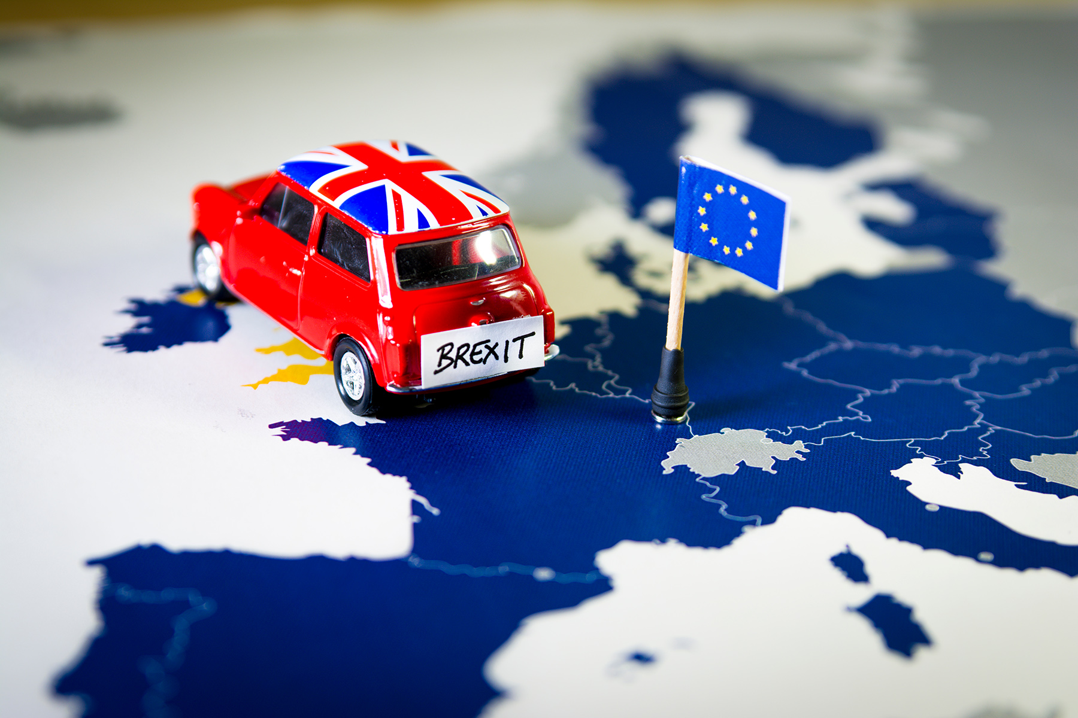
NLP Final Project
Roy Madpis & Michael Kobaivanov

Slide 2




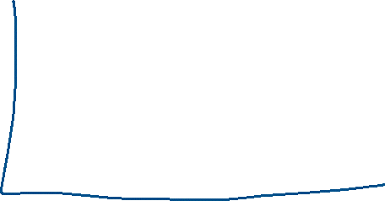


Slide 3
THE AGENDA
Introduction
01
Modeling
02
Visualizing
03
Displaying the visualization outcome and inights
Background on Brexit and the Research question
CONCLUSIONS
04
Displaying the process we have done and the models
Takeaways and further
possible analysis/research

Slide 4
01
Introduction

Slide 5
Introduction
01
Brexit was the withdrawal of the UK from the European Union. It happened on the 31 of January 2020 following a referendum held on 23 June 2016 (51.89% voted in favor of leaving the EU)
Many studies have analyzed the role of social media during Brexit
We would like to further analyze the Brexit using NLP
We used Word2Vec, Doc2Vec and Sentiment Analysis models for our research
Notes:
https://www.tandfonline.com/doi/full/10.1080/13825577.2021.1918842

Slide 6


The Data
01
In order to conduct our analysis, we needed massive amount of tweets. Therefore, we used a package that we developed thought the year for retrieving data from twitter, we added some new functions to this package for this project.

Slide 7
The Data
01
We have used the package to retrieve 3 types of data:
400K tweets of Key Opinion leaders
500K tweets that include the phrase “Brexit” (twitted in 2014 – 2021)
Labeled tweets – we have corpus of 4.5M tweet ids with sentiment label, we exported +300K tweets using the given tweet-ids and added the given sentiment label to them.
A total of 1.3M tweets
*The data retrieval process is displayed in notebooks:
Step_0 Retrieve tweets of brexit.ipynb
Step_1_Read_KOL_tweets.ipynb
Notes:
להסביר שמדובר בטוויטים של KOL בין 2014-2021
ייבאנו כ- 60 אלף ציוצים מכל שנה (יש שנים שייבאנו יותר כדי שיהיה יחסית כמות דאטא שיוויונית בכל שנה), נציין שמ-2014 ייבאנו את כל הטוויטים שהכילו את המילה ברקזיט (מדובר בכמה עשרות אלפים בלבד)
מצאנו מחקר שביצע בעצמו label לכ-4.5 מיליון ציוצים, הוא פירסם את הדאטא סט שמורכב מ 4.5 מליון tweet ids בעמודה 1 ובעמודה השנייה ה-sentimer (חיובי / שלילי / נייטרלי). יצרנו יכולת בחבילה להביא טוויטים בהינתן רשימה של tweet-ids, וכך ייבאנו כ-200 אלף מתוכם והוספנו להם את ה-label

Slide 8
The Research Question
01
How the phrase “Brexit” changed over time
How the sentiment of KOL and the overall public changed over time
Does the KOL “known” agenda corresponds with the tweets he published?
Notes:
ישנן מספר שאלות שאנו מבקשים לנתח בעבודה שלנו.
השאלה הראשונה באה לבחון את המילה "ברקזיט" ואת השינוי שלה לאורך זמן – את זה נבצע באמצעות מודל Word2Vec ועוד רגע נרחיב על זה
השאלה השנייה באה לבחון את השינוי בסנטימנט של KOLs ושל הציבור בכלל – אנו מעוניינים לראות האם הוא השתנה לאורך זמן, ואם כן לנסות להבין מה יכול היה לגרום לשינוי הזה (אנו נרצה לראות טרנדים)
השאלה השלישית באה לבחון האם האג'נדה הלכאורה ידועה של KOL אכן מתכתבת עם הציוצים שלו. למשל – אם יש נציג ציבור ממפלגה ימנית שהתבטא כי הוא בעד הברקזיט, האם גם בציוצים שלו ניתן לראות כי מרביתם בעד הברקזיט או שמא כך לא הדבר?

Slide 9
02
Modeling + Visualizing
03
Word2Vec + Doc2VEC model (+TSNE) & Sentiment Analysis model

Slide 10
Modeling approach – Word2Vec
02
Step 1: Preprocess
Preprocess the tweets-text (cleaning, stopwords, tokenizing, etc)
Split the tweets according to the twitted year, so we have 8 groups of tweets (2014-2021)
Step 2: Build Word2Vec models
Building a models for each year + an overall model with all the data
*The Preprocess and Word2Vec modeling is displayed in :
Step_2 filter_KOL_tweets.ipynb
Step_5_Visualizing_Word2Vec and Sentiment Analysis.ipynb

Slide 11
Modeling approach – Word2Vec
02
Step 3: find K most similar words
Use the Word2Vec model to find the 30 most similar words to the word “Brexit”
Step 4: TSNE
Apply TSNE on the data and display the 30 most similar words to “Brexit” in a plot
*The Preprocess and Word2Vec modeling is displayed in:
Step_2 filter_KOL_tweets.ipynb
Step_5_Visualizing_Word2Vec and Sentiment Analysis.ipynb

Slide 12
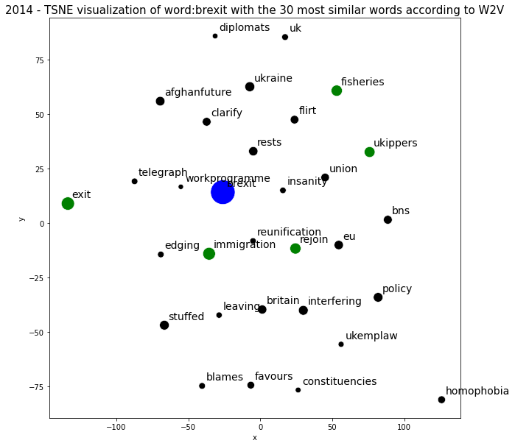
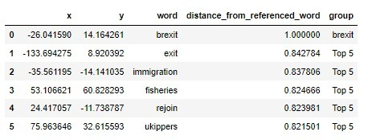
03
Visualizing Word2Vec & TSNE Output
We wish to see how the representation of the word “Brexit” changed over the years + how the 30 most similar words to “Brexit” changed as well.

Slide 13
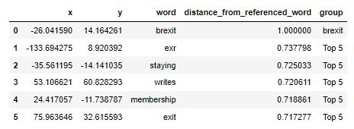
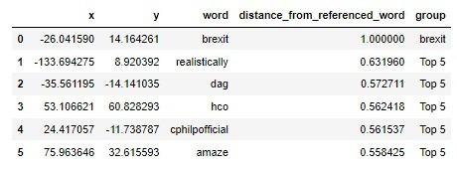
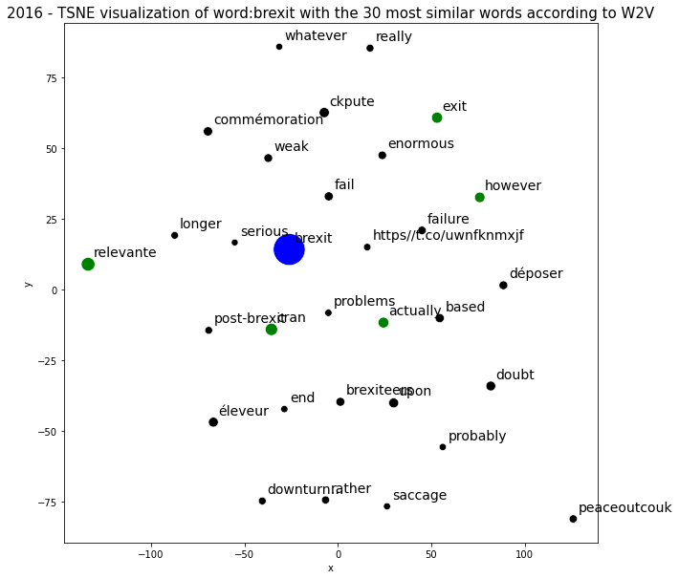
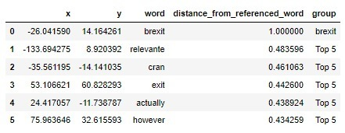
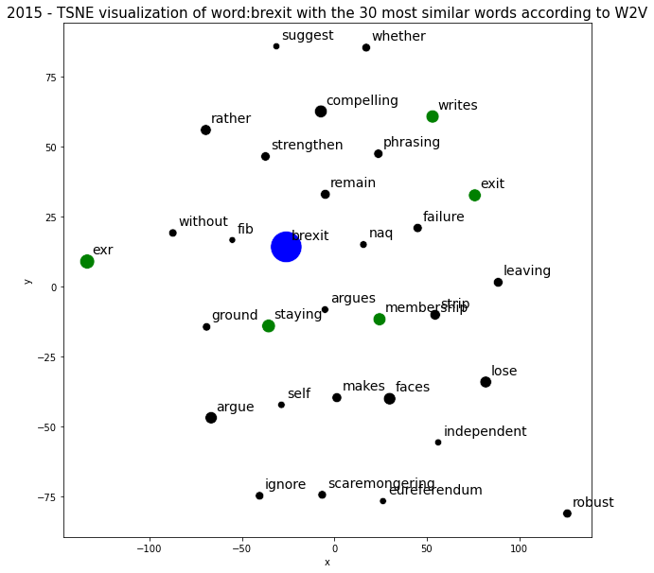
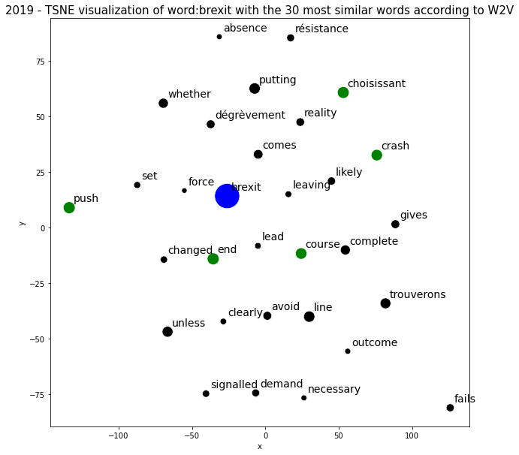
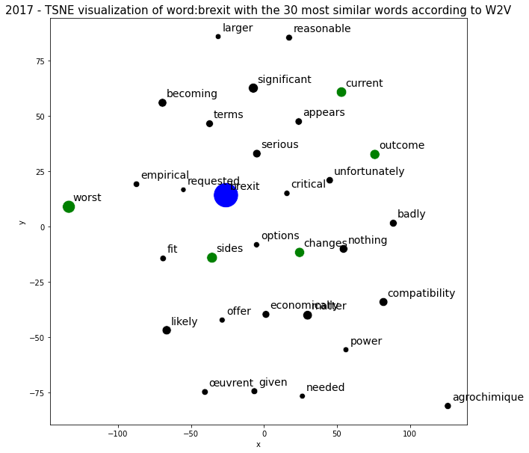
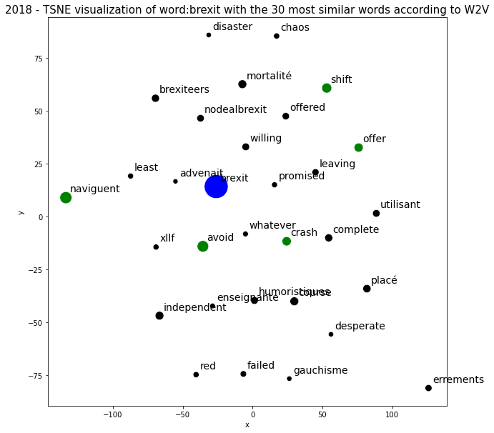
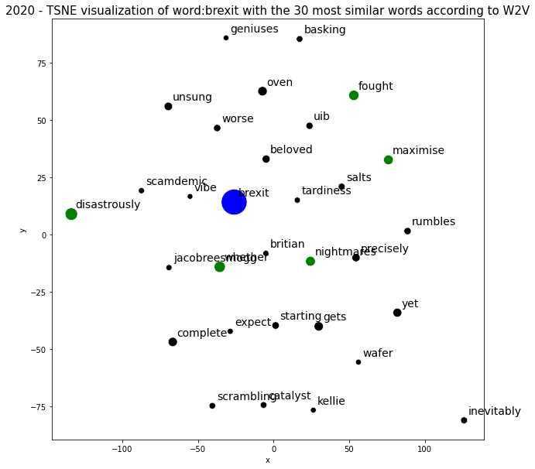
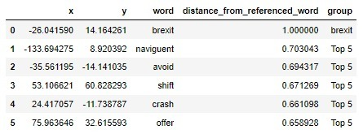
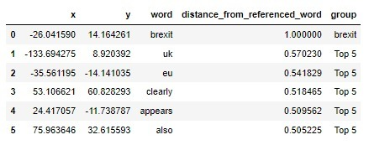
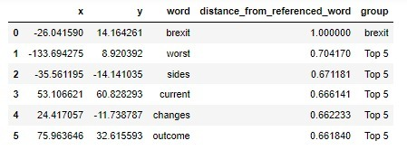
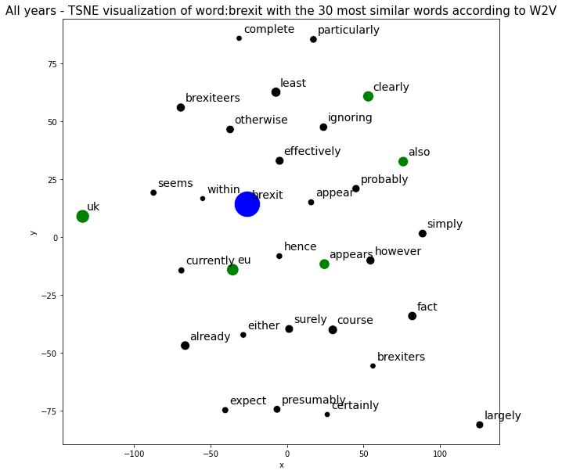
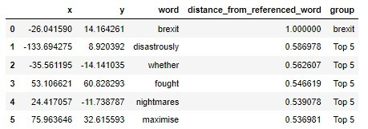
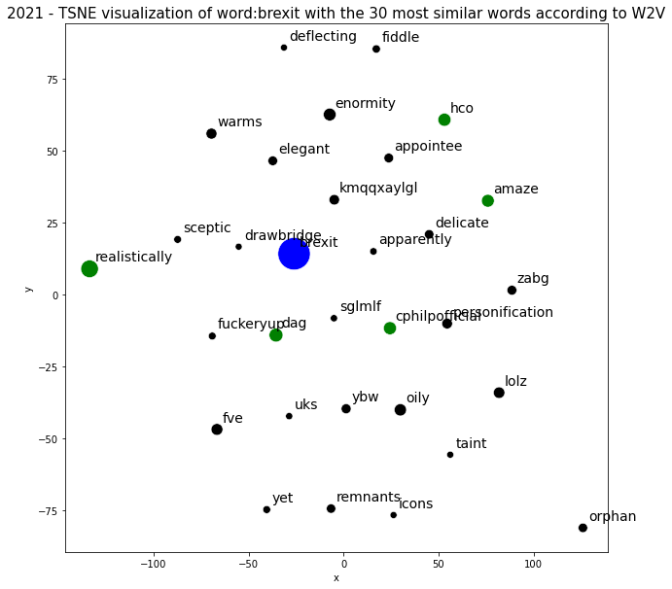
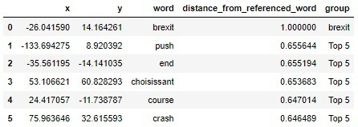
03
2017
2016
2019
2015
2018
2020
2014 - 2021
2021

Slide 14
Modeling approach – Doc2Vec
02
We have built a Doc2Ve model using all the data, applied TSNE on the word “Brexit” and the 30 most similar words
Unfortunately, the results weren’t so insightful, so we won’t focus on them
*The Preprocess and Word2Vec modeling is displayed in:
Step_2 filter_KOL_tweets.ipynb
Step_5_Visualizing_Word2Vec and Sentiment Analysis.ipynb

Slide 15
Modeling approach – Sentiment Analysis
02
Step 1: Import model from hugginface
We import a sentiment analysis model from hugginface, the model was trained on ~124M tweets from January 2018 to December 2021 and finetuned for sentiment analysis with the TweetEval benchmark
*The Sentiment Analysis modeling is displayed in notebooks:
Step_3_Sentiment_Analysis.ipynb
Step_4_Sentiment_labels.ipynb
Step_5_Visualizing_Word2Vec and Sentiment Analysis.ipynb

Slide 16
Modeling approach – Sentiment Analysis
02
Step 2: fine-tune the model
We wish to fine-tune the imported sentiment model using the ~300k tweets with sentiment label on Brexit we have.
Note that this step is very important as the regular imported model predict if a given tweet is positive/neutral/negative not necessarily regarding Brexit
*The Sentiment Analysis modeling is displayed in notebooks:
Step_3_Sentiment_Analysis.ipynb
Step_4_Sentiment_labels.ipynb
Step_5_Visualizing_Word2Vec and Sentiment Analysis.ipynb

Slide 17
Modeling approach – Sentiment Analysis
02
Step 3: Predicting the sentiment
Using the fine-tuned model to predict the sentiment on the ~1.1M tweets we have.
*The Sentiment Analysis modeling is displayed in notebooks:
Step_3_Sentiment_Analysis.ipynb
Step_4_Sentiment_labels.ipynb
Step_5_Visualizing_Word2Vec and Sentiment Analysis.ipynb

Slide 18
03
Visualizing the Sentiment
We would like to take the 20 KOL with the most tweets in the given time-frame (2014-2021) and examine how their sentiment changes over time

Slide 19
03
2017
2016
2019
2015
2018
2020
2014 - 2021
2021

Slide 20
03
EDA
Modeling approach + performance on train + test sets

Slide 21
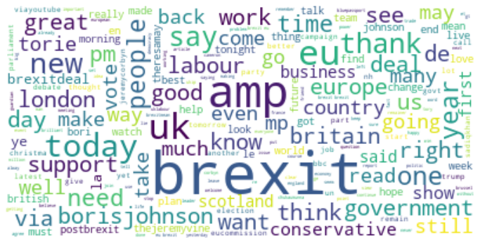
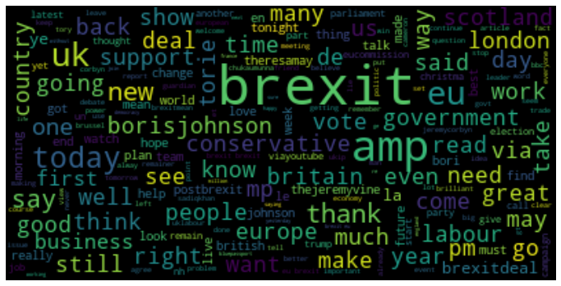
Word-Cloud
02

Slide 22
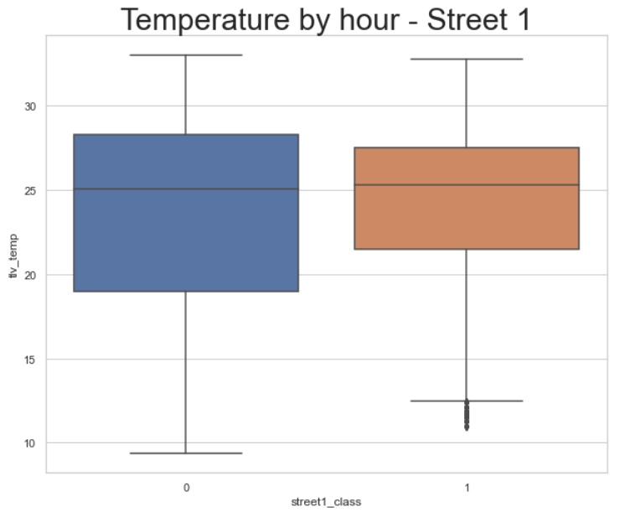
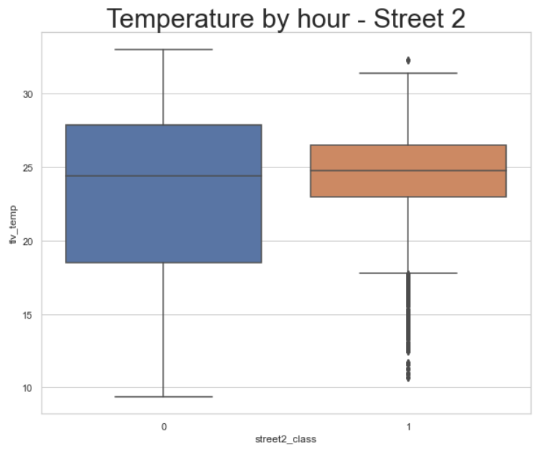
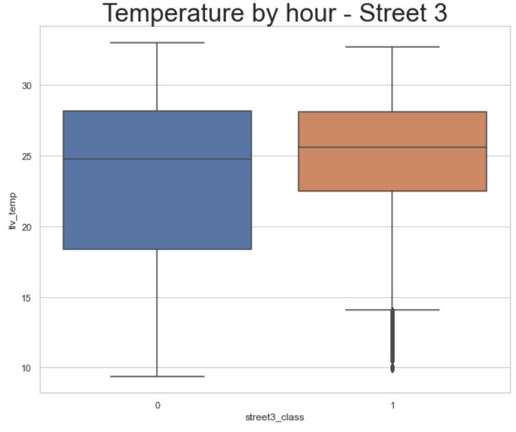
Parking clearness cases vs Temperature
02
Street 1
Street 2
Street 3
0 = There isn’t an available parking spot
1 = There is an available parking spot
It is more likely to get a free parking spot with Higher temp

Slide 23
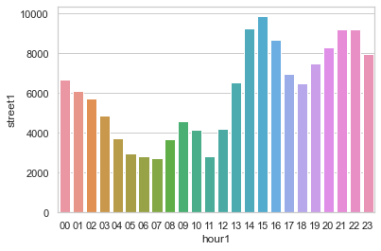
Parking clearness cases vs time graph – street 1
02
In street 1 - Most of the parking clearness cases occur between 14:00 – 22:00

Slide 24
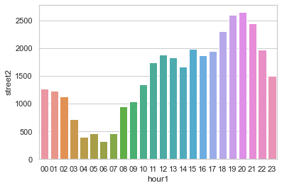
Parking clearness cases vs time graph – street 2
02
In street 1 - Most of the parking clearness cases occur between 17:00 – 21:00

Slide 25
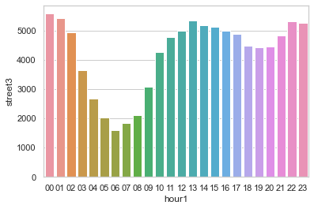
Parking clearness cases vs time graph – street 3
02
In street 1 - Most of the parking clearness cases occur between 11:00 – 01:00

Slide 26
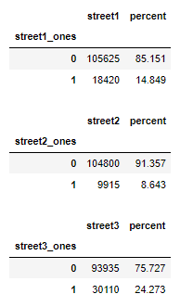
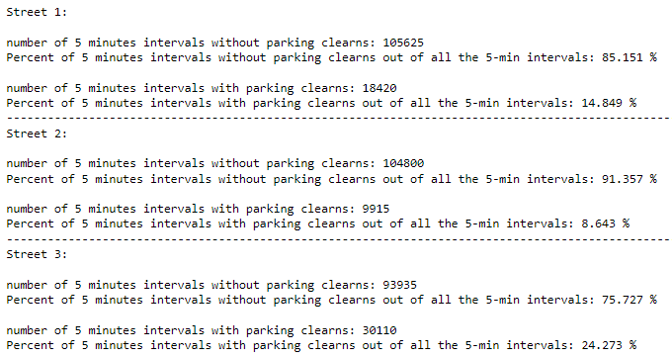
5 min intervals with parking clearness out of the total 5 min intervals for each street
02

Slide 27
04
Conclusions
Main Conclusions and Key Takeaways & further
possible analysis/research

Slide 28
Key Takeaways & Conclusion
The Brexit was a major event that had a great impact on UK from many different aspects (social, economical, political, etc)
We used NLP methods on tweets between 2014-2021 to analyze some aspects of the Brexit event
Using word2vec models and TSNE We found that the context of the word “Brexit” was changed through those 8 years, it was closer to negative words
Using the fine-tuned sentiment analysis model we discovered that …

Slide 29
Key Takeaways & Conclusion
We believe that further research can be done on the realm of the sentiment analysis – using more tweets with sentiment labels and a powerful GPU – train/fine-tune a sentiment analysis model that is able to predict whether a given tweet is positive/neutral/negative regarding the Brexit (and not predicting only the overall tweet’s sentiment)
Using word2vec models and TSNE We found that the context of the word “Brexit” was changed through those 8 years, it was closer to negative words
Using the fine-tuned sentiment analysis model we discovered that …

Slide 30
THANK YOU

